Slide 1
Recommender System
Team: RS
Team Member: Yang Xu

Slide 2
Abstract
Through recommender system, items will be recommended to user that suit his/her personal taste.
Collaborative filtering approach is widely used to predict user’s interests based on user rating history.
In this project, we implement some existing algorithms to do recommendation for one dataset.

Slide 3
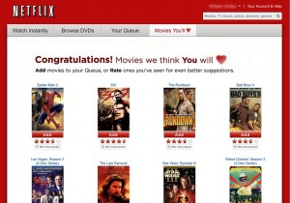
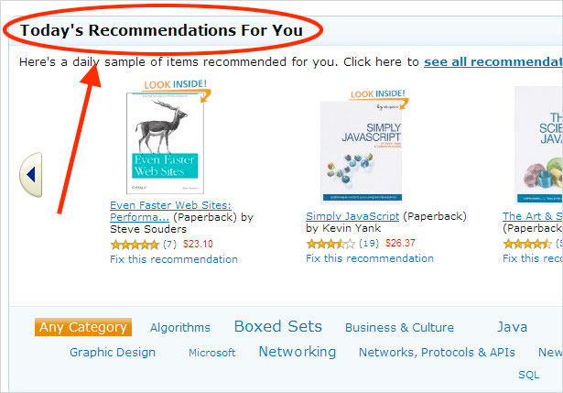
Motivation
Many companies do recommendation:
E.g., Amazon, Netflix, Spotify, Pandora
Many companies set up dataset challenge to find better recommendation solution

Slide 4
Background
The recommender problem: Estimate a utility function that automatically predicts how a use will like an item.
The age of recommendation is coming:
Information overload
Personalized feature
“We are leaving the age of information and entering the age of recommendation” Chris Anderson in “The Long Tail”

Slide 5
Data Source
Yelp Challenge Dataset:
Data from Phoenix, LasVegas, Madison, Waterloo and Edinburgh:
42,153 businesses
320,002 business attributes
31,617 check-in sets
252,898 users
955,999 edge social graph
403,210 tips
1,125,458 reviews
Only utilize rating information

Slide 6
Design Diagram
Data Flow and Components
Data Input
Training Data
Filtering &&Sampling
Test Data
Run in Hadoop
Recommendation Model
Generate Recommendation
Accuracy Assessment

Slide 7
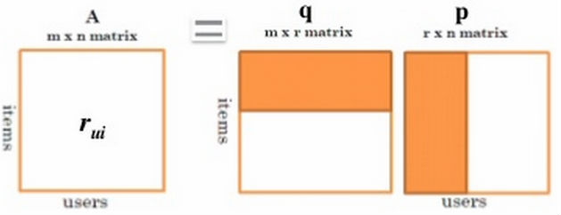
Matrix Factorization Model
Solve this using alternating least squares (ALS)
1. Initialize P by assigning random number
2. Fix P, solve Q to minimize the objective function
3. Fix U, solve P to minimize the objective function
4. Repeat step 2 and step 3
Step 2 and step 3 could be realized via parallel map/reduce jobs.

Slide 8
Other Models
Item-based model
Compute similarity between items using the rating of users who have interacted with both items
Predict rating of unrated item using user’s rating history and item similarity
Popularity model
Use item’s mean rating for the prediction

Slide 9

Results
Measure root-mean-square deviation (RMSD):
The smaller the better
RMSD result:
Approach | RMSD
Item-based model | 1.2389
Popularity model | 1.1927
Matrix factorization model | 1.1557

Slide 10
Obstacles
Haven’t studied recommendation model previously.
Initial design are too complicated to realize in a short time.

Slide 11
Conclusion && Future work
Good practice and good learning opportunity
Hadoop is not suitable for iterative computing like matrix factorization (temporary result to disk). Spark is more suitable.
In the future, try to realize the recommendation model by considering other information, e.g., text review information, friend information.

Slide 12
Acknowledgements
Thanks Amazon for AWS Grant Support

Slide 13
Reference
Koren, Yehuda, Robert Bell, and Chris Volinsky. "Matrix factorization techniques for recommender systems.", in Computer 42.8 (2009): 30-37.
Yang, Xiwang, Harald Steck, and Yong Liu. "Circle-based recommendation in online social networks.", in ACM KDD, 2012.
Yang, Xiwang, et al. "On top-k recommendation using social networks.", in ACM Recsys, 2012.
McAuley, Julian, and Jure Leskovec. "Hidden factors and hidden topics: understanding rating dimensions with review text.", in ACM Recsys, 2013.
Diao, Qiming, et al. "Jointly modeling aspects, ratings and sentiments for movie recommendation (JMARS)." in ACM SIGKDD, 2014.

